Slide 1


Slide 2
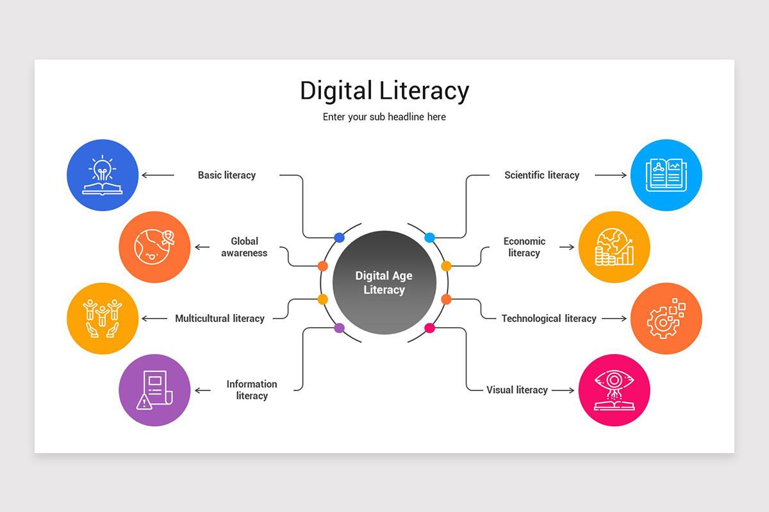

Slide 3


Slide 4
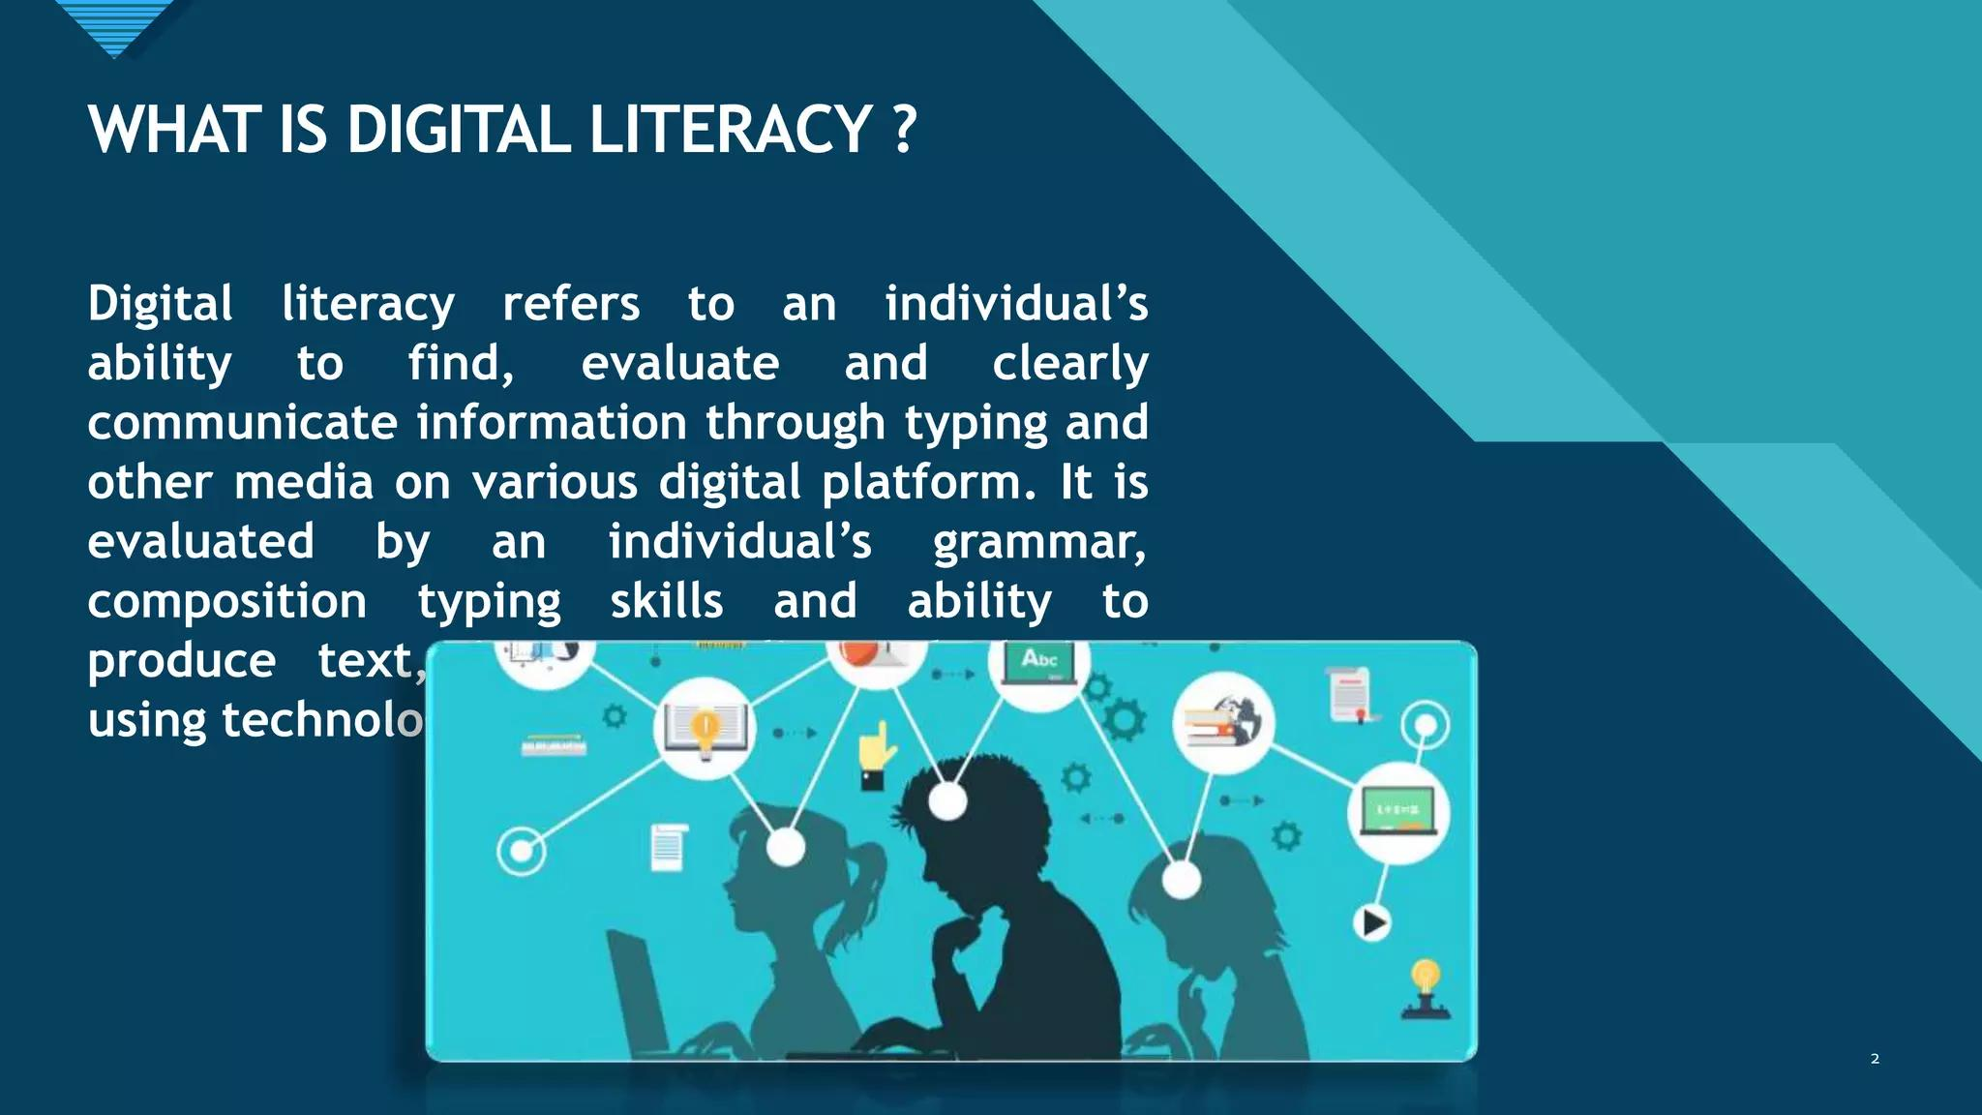

Slide 5
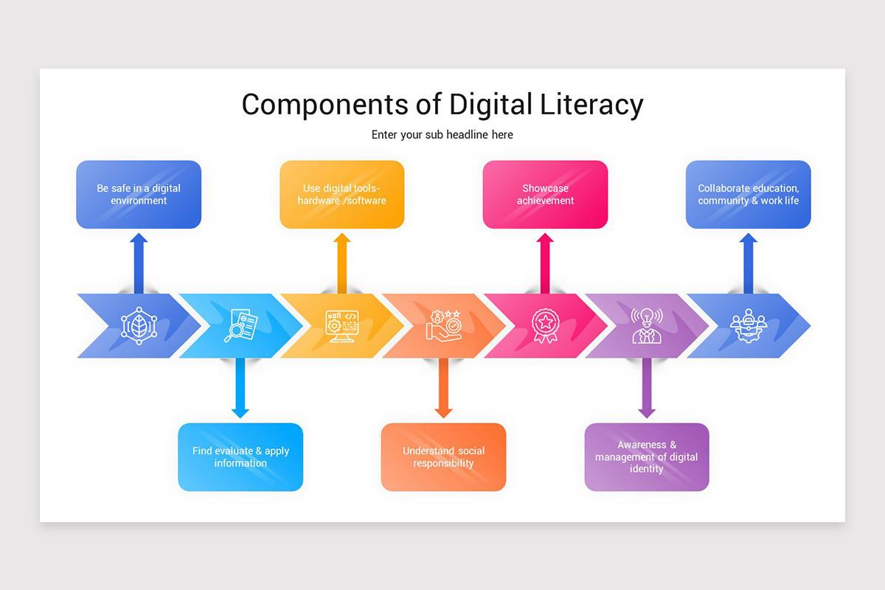

Slide 6

THANK YOU
NAME :MASOOM ALI
REG NO.:25BAI11210
SUB: DIGITAL LITERACY

